Slide 1

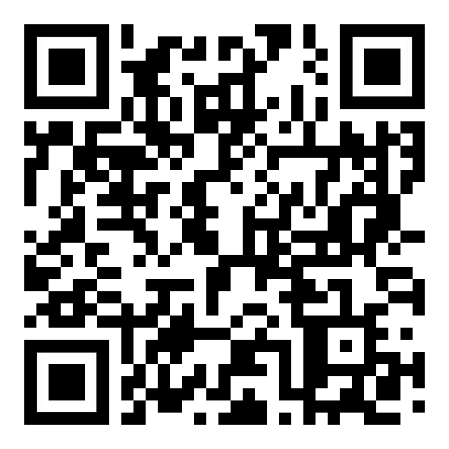
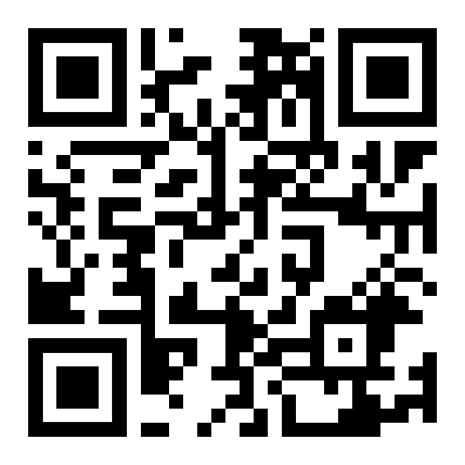






AnDi 2 seminar
an end-to-end guide to the challenge
challenge website
arXiv manuscript
organizers

Slide 2
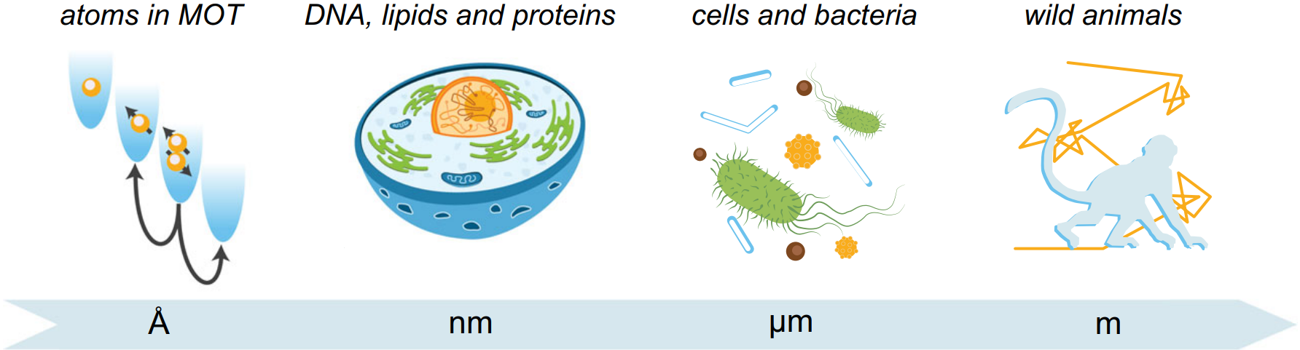
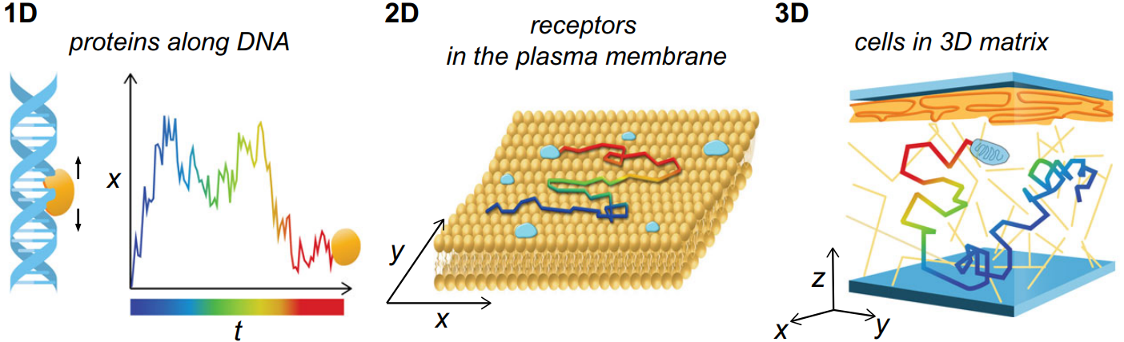
the Anomalous Diffusion challenge 2
…. is the random motion of particles suspended in a medium.
At all scales …
… and any dimension.

Slide 3
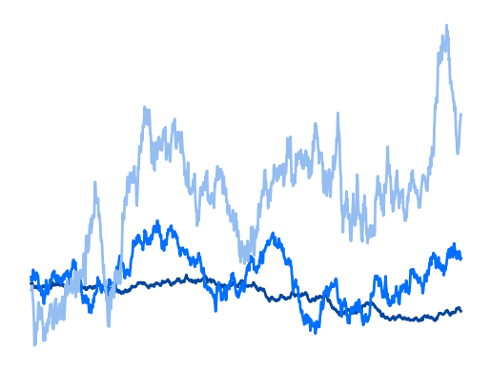
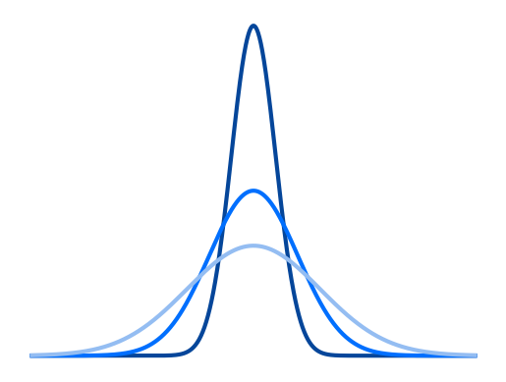
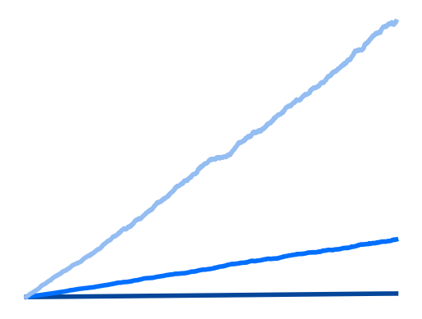
the Anomalous Diffusion challenge 2
…. is the random motion of particles suspended in a medium.
Normal diffusion ( = Brownian motion)
position
∆x
P(∆x) = N(0, σ)
K
MSD
time
MSD ~ K t
∆x
time

Slide 4
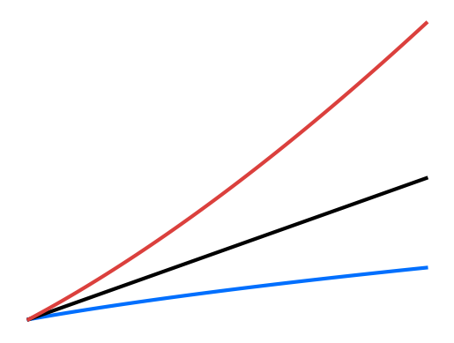
the Anomalous Diffusion challenge 2
…. describes motions that deviate from normal / Brownian diffusion.
Heterogeneous environments
Trapping
Viscoelastic collisions
MSD
MSD ~ K t ^{α}
time

Slide 5

from AnDi 1 to AnDi 2
exponent α + diffusion model
AnDi 1
What if…
… trajectory comes from unknown model?
… changes parameters / model over time?
What is the source of “transient” anomalous diffusion?
How to properly characterize experimental datasets?

Slide 6

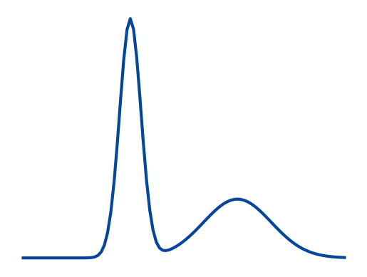
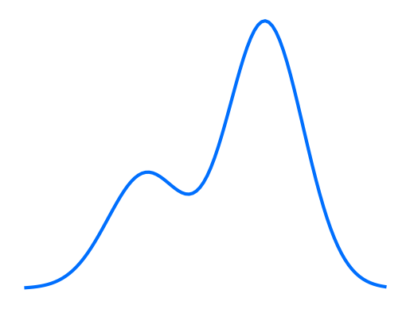
from AnDi 1 to AnDi 2
single- trajectory
α₃, K₃
α₁, K₁
changepoint
changepoint
α₂, K₂
ensemble
AnDi 2
α
K

Slide 7
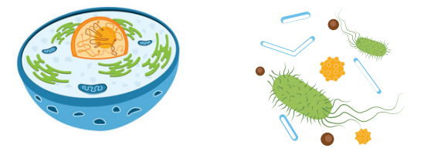
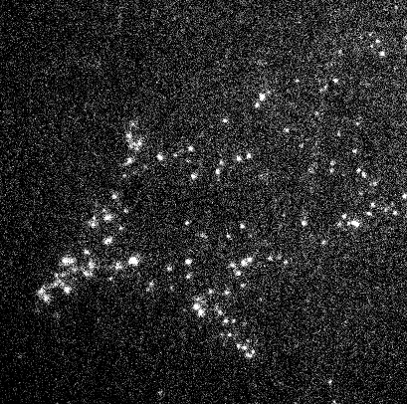
from AnDi 1 to AnDi 2
beyond trajectories
DNA, lipids, proteins
cells and bacteria
Looking into the microworld is a challenge!
videos
trajectory
diffusion parameters
???

Slide 8
AnDi2 challenge
Evaluation of methods to analyze
motion changes in single-particle
experiments
ensemble
Track 1
videos
Track 2
trajectories
single-trajectory
Important: you decide where to participate!

Slide 9
Outline
Experimental setup
Trajectories (Track 2)
Videos (Track 1)
Tasks
Single-trajectory task
Ensemble task
Challenge interface

Slide 10
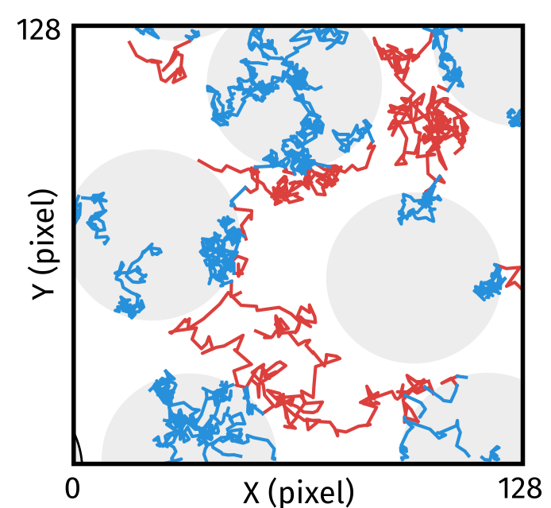
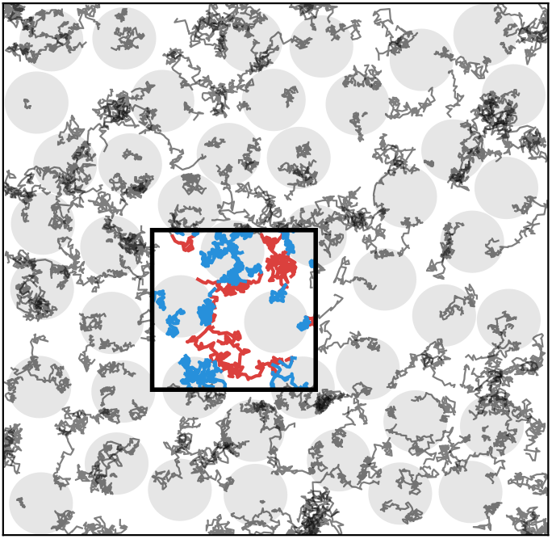
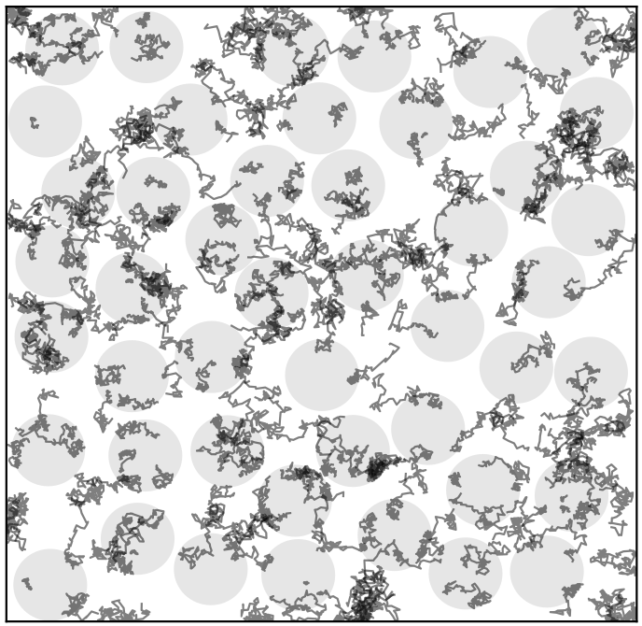
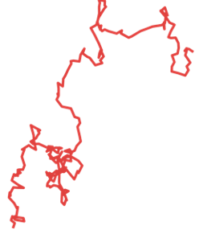
1. Experimental setup
Experiment
a biological replicate with fixed interaction model and parameters
Field of view (FOV)
mimics the acquisition of data in bio-experiments
Trajectory
behavior of an individual molecule

Slide 11
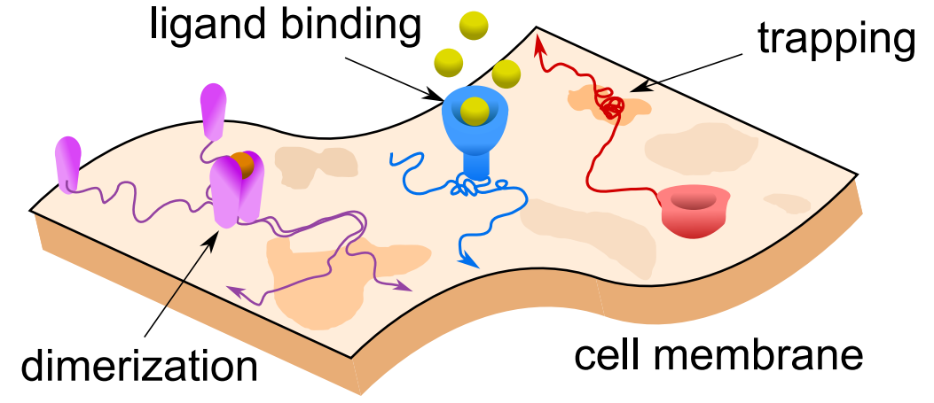
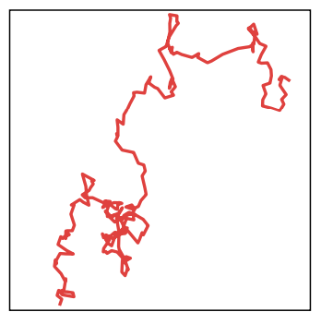
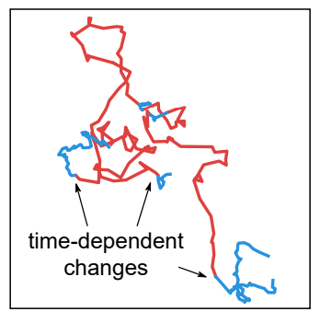
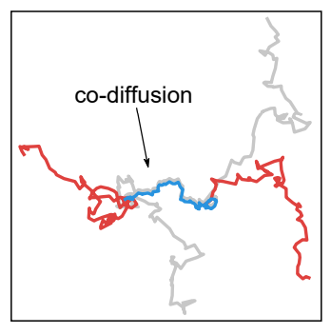
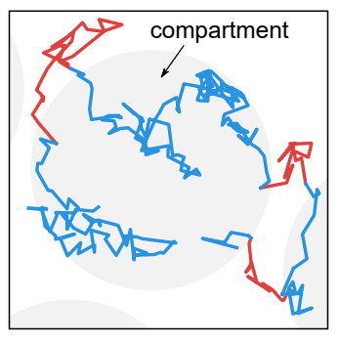
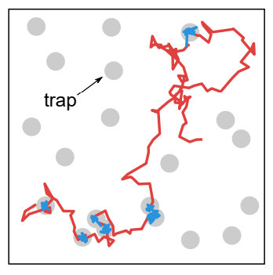
2. Trajectories (Track 2)
phenomenological models
We try to reproduce the typical behavior of a particle moving in the cell membrane.
→ base motion: fractional Brownian motion with K є [10⁻¹²,10⁶] and α є [0, 2]
From here, we consider 5 different models:
Explore the models at:
andi_datasets > Tutorials > Challenge 2 datasets (link)

Slide 12
2. Trajectories (Track 2)
phenomenological models
single-state: trajectory with constant properties
Parameters:
anomalous exponent α
diffusion coefficient K

Slide 13
2. Trajectories (Track 2)
phenomenological models
multi-state: trajectory with random changes between diffusive states
Parameters:
number of states
transition matrix M (rates at which states change)
diffusive properties for each state ( α₁, α₂, … and K₁, K₂, … )

Slide 14
2. Trajectories (Track 2)
phenomenological models
dimerization: particles have certain probability of binding if close to each other
Parameters:
size of the particles
binding / unbinding probability
diffusive properties for each state ( α₁, α₂ and K₁, K₂ )

Slide 15
2. Trajectories (Track 2)
phenomenological models
transient-confinement: particles diffuse in an environments of compartments
Parameters:
number / size of compartments
transmittance of the boundary (osmotic)
diffusive properties for each state ( α₁, α₂ and K₁, K₂ )

Slide 16
2. Trajectories (Track 2)
phenomenological models
quenched-trap: particles diffuse but can be trapped for certain time
Parameters:
number / size of traps
binding / unbinding probabilities
diffusive properties of the free state (α and K)

Slide 17
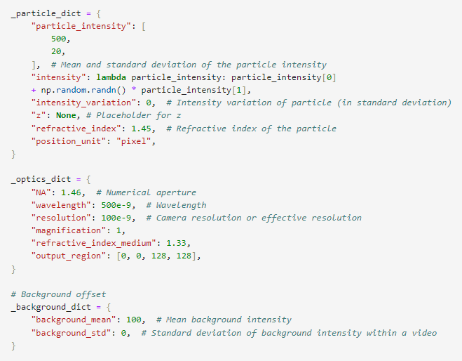

3. Videos (Track 1)
deeptrack based generation
same trajectories as before
Diffraction limited
Intensity varies in time
Different intensity particle to particle
No blinking
Static noise
All details in andi_datasets > Tutorials > Creating videos (link)
Default values of props used in the challenge found in utils_videos.transform_to_video (link)

Slide 18
4. Tasks
tasks
ensemble
Track 1
videos
Track 2
trajectories
single-trajectory

Slide 19
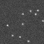
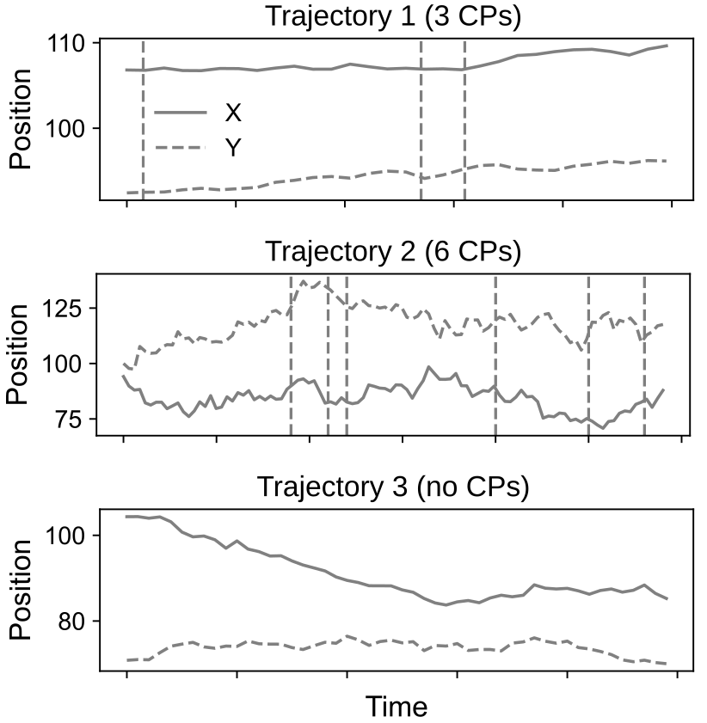
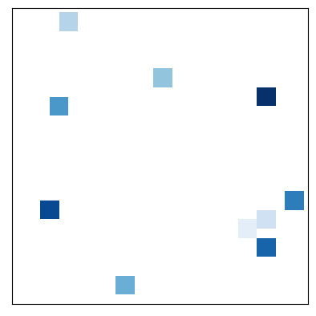
4.1 Single-trajectory task
Track 1
videos
Track 2
trajectories
first frame:
VIP particles
Y ( px)
VIP index
(from 0 to N_{vip})
X ( px)
only predictions for VIPs!

Slide 20
4.1 Single-trajectory task
some properties of trajectories
Trajectory length
from 20 to 500 frames
Changepoints
from 0 to ? per trajectory
min segment length = 3 frames
Diffusive properties
each trajectory has fixed properties (for each state)
parameters are distanced to allow characterization

Slide 21
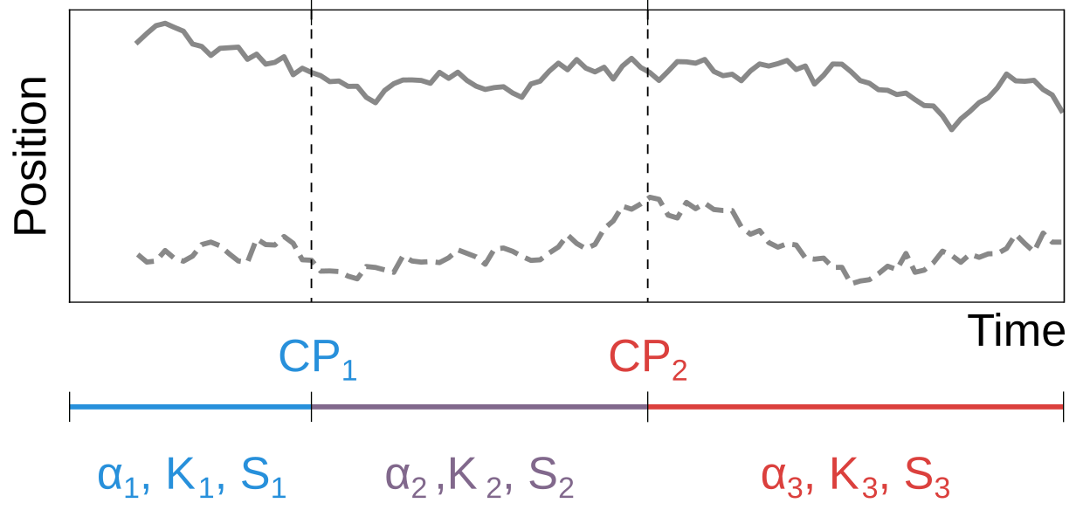
4.1 Single-trajectory task
Challenge:
for every trajectory (VIP for Track 1), segment the trajectory and return:
changepoints
exponent alpha α
diffusion coefficient K
diffusive state
0: trapping
1: confined
2: free normal / anomalous diffusion
3: direction motion (α > 1.9)

Slide 22
4.1 Single-trajectory task
Metrics
CP₁
CP₂
CP₃
CP₄
α₁ , K₁ , s₁
α₂ , K₂ , s₂
α₃ , K₃ , s₃
α₄ , K₄ , s₄
α₅ , K₅, s₅
True
Predicted
α’₁ , K’₁ , s’₁
α’₂ , K’₂ , s’₂
α’₃ , K’₃ , s’₃
α’₄ , K’₄ , s’₄
α’₅ , K’₅ , s’₅
CP’₁
CP’₂
CP’₃
CP’₄

Slide 23
4.1 Single-trajectory task
Metrics
FN
FN
CP₁
CP₂
CP₃
CP₄
True
TP
TP
Predicted
CP’₁
CP’₂
CP’₃
CP’₄
FP
FP
Changepoint detection
1) Segment pairing by distance between CP
TP: if |CP_{i} - CP’_{i}| < 10 frames
FP: if not CP_{i}
FN: if not CP’_{i}
2) Calculate Jaccard Similarity Coefficient (JSC) (Eq. 8):
or |CP_{i} - CP’_{i}| > 10
3) Calculate Root Mean Square Error (RMSE) of TP (Eq. 9).

Slide 24
4.1 Single-trajectory task
Metrics
α₁ , K₁ , s₁
α₂ , K₂ , s₂
α₃ , K₃ , s₃
α₄ , K₄ , s₄
α₅ , K₅, s₅
True
Predicted
α’₁ , K’₁ , s’₁
α’₂ , K’₂ , s’₂
α’₃ , K’₃ , s’₃
α’₄ , K’₄ , s’₄
α’₅ , K’₅ , s’₅
Diffusion properties
Final score
Your final rank is calculated with mean reciprocal rank:
R = sum(1 / R_{i})
→ R_{i} is your rank at each metric (changepoint + diff. prop.)
1) Segment pairing by overlaps
2) From each associated segment (discard not paired!):
Mean Absolute error (MAE, Eq. 11) of α
Mean squared log error (MSLE, Eq. 10) of K
F1-score (F1, Eq. 12) of diffusive states s

Slide 25
4.2 Ensemble task
tasks
ensemble
Track 1
videos
Track 2
trajectories

Slide 26
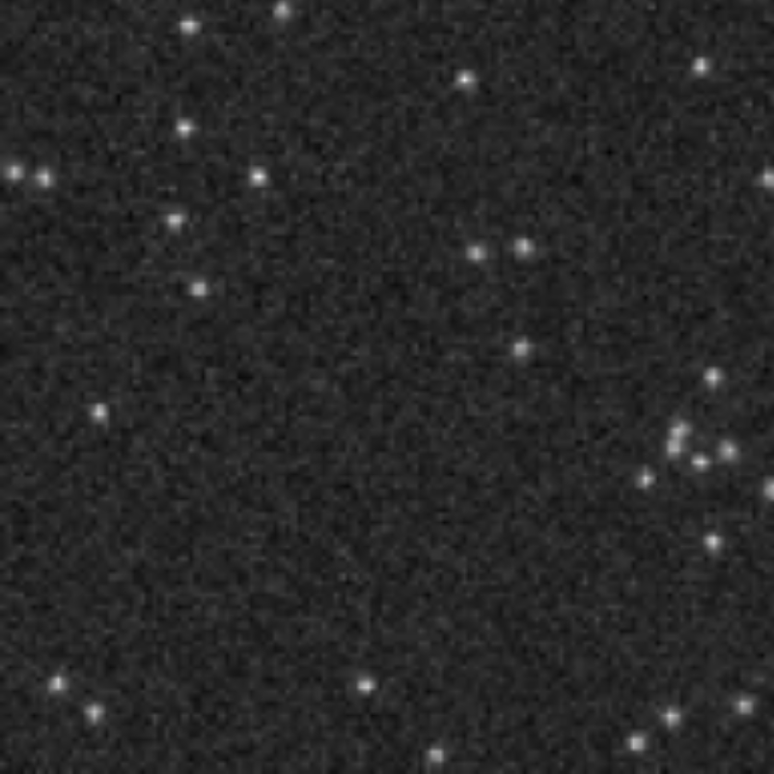
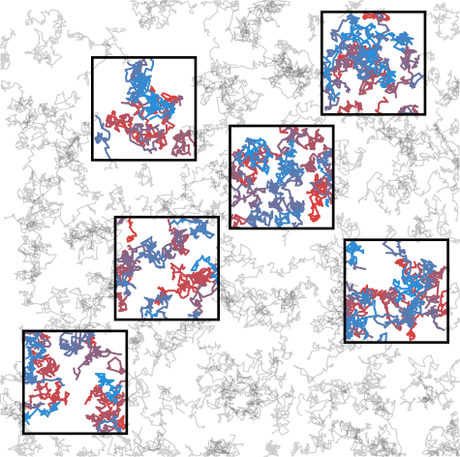
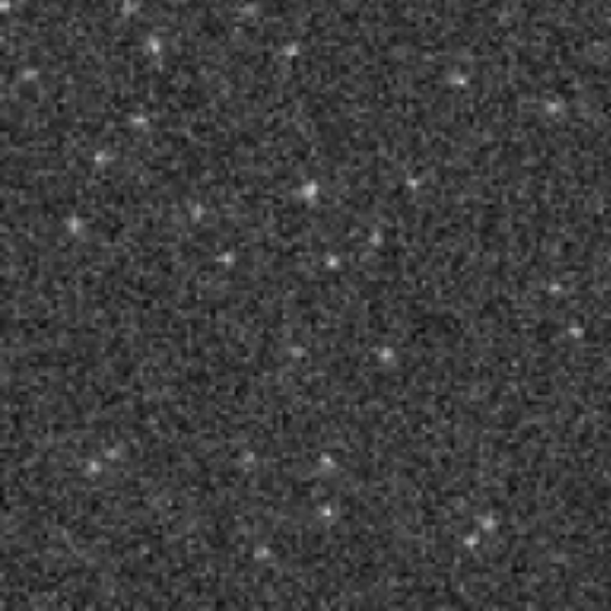
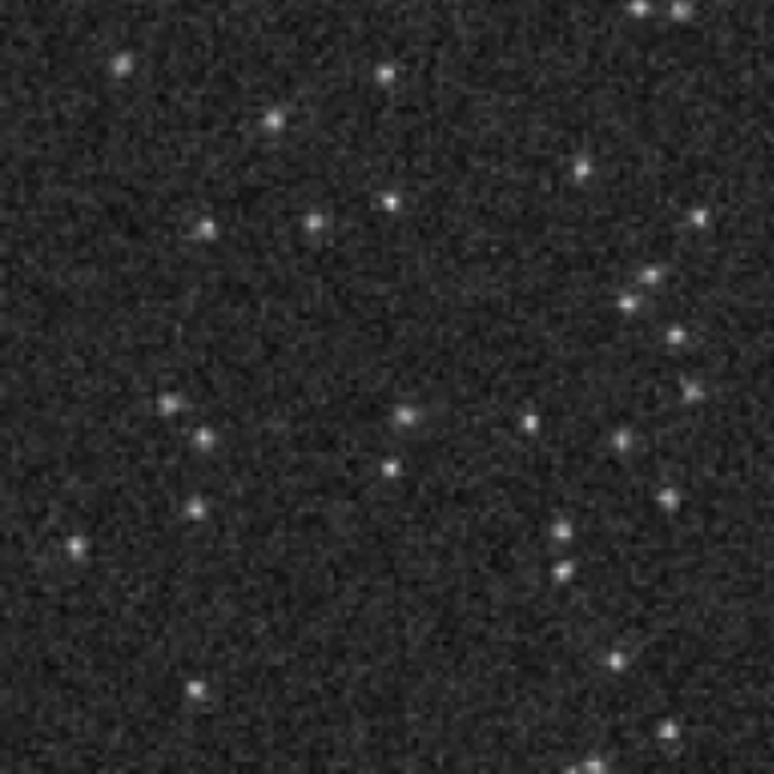
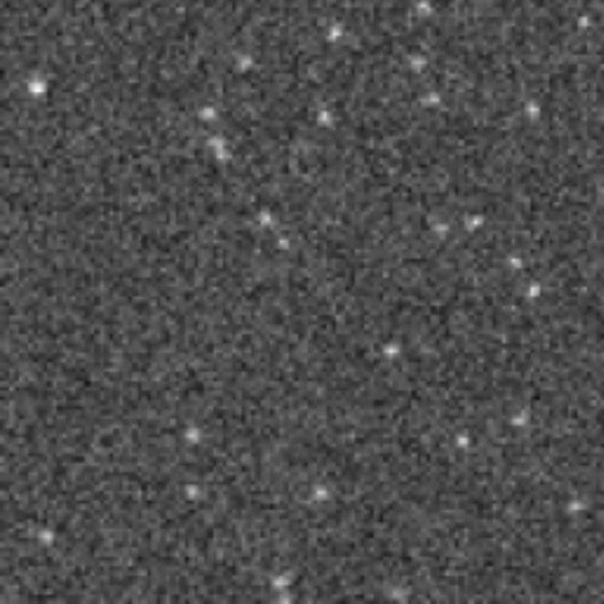
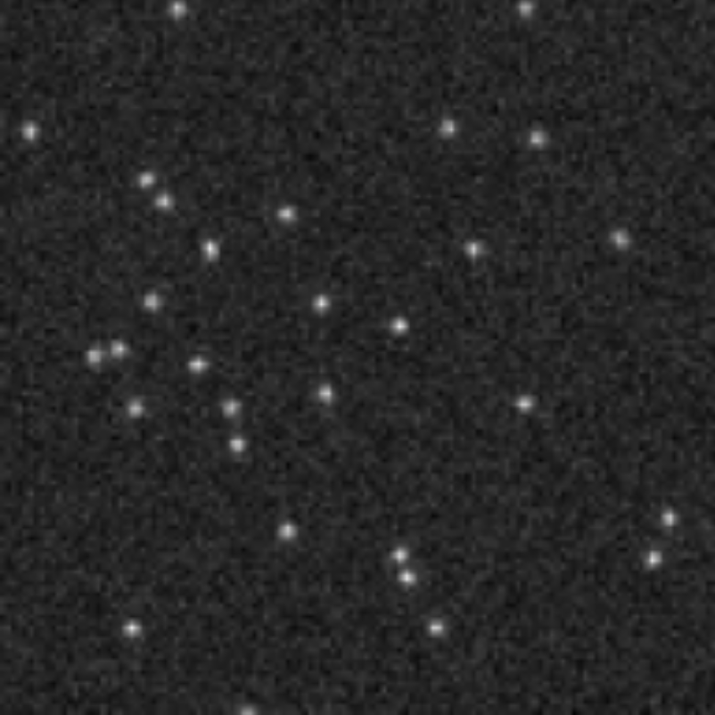
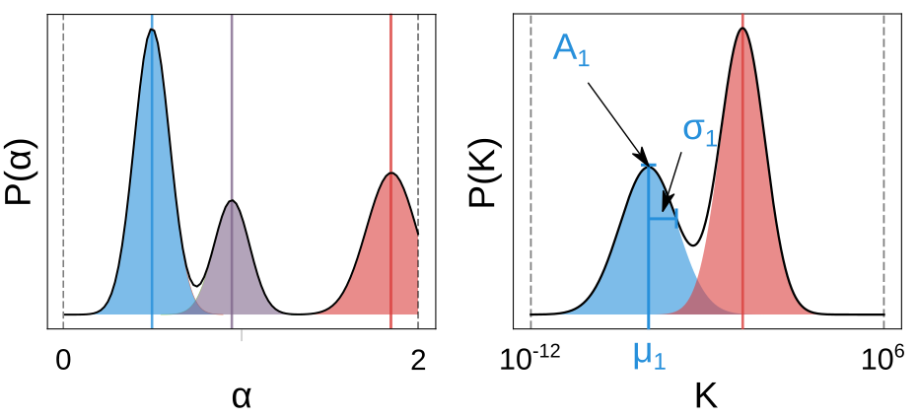
4.2 Ensemble task
Track 1
videos
Track 2
trajectories
Challenge
for every experiment distribution of α and K
use all trajectories, not only VIP!
TIP: if you did single-trajectory, you get ensemble “for free”!

Slide 27
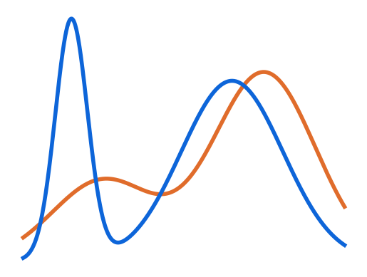
4.2 Ensemble task
Metrics
Distribution are always multimodal.
Your input is the mean, variance and weight of each “population”.
True
Predicted
0
α
2
support of each property
10⁻¹²
K
10⁶
For both properties:
Wasserstein-1 distance (W1, Eq. 3) between true and predicted distributions.

Slide 28
5. the Challenge interface
https://codalab.lisn.upsaclay.fr/competitions/16618

Slide 29
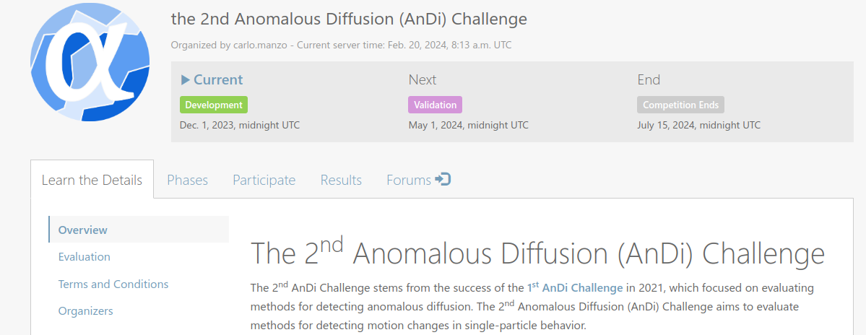
5. the Challenge interface
all you need to know to succeed in the challenge

Slide 30
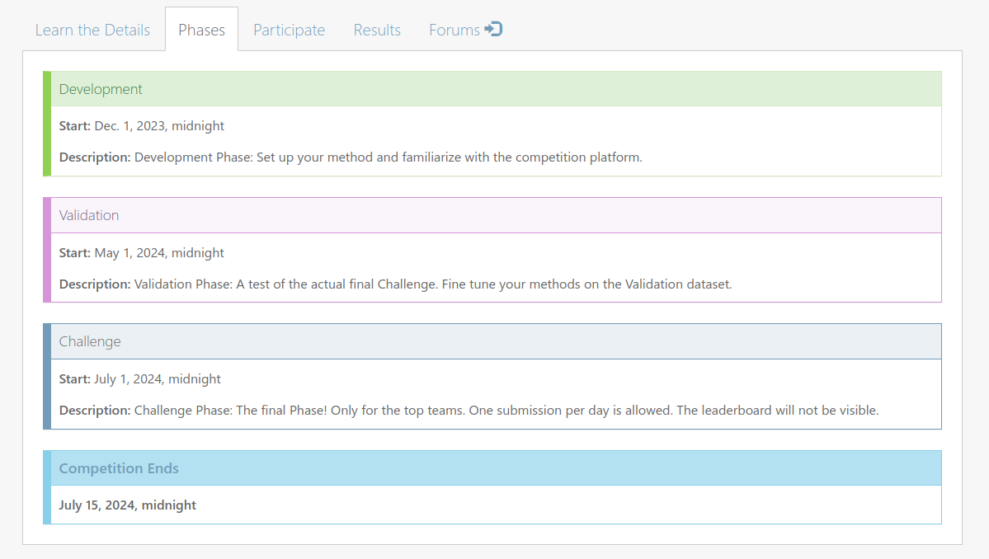
5. the Challenge interface

Slide 31
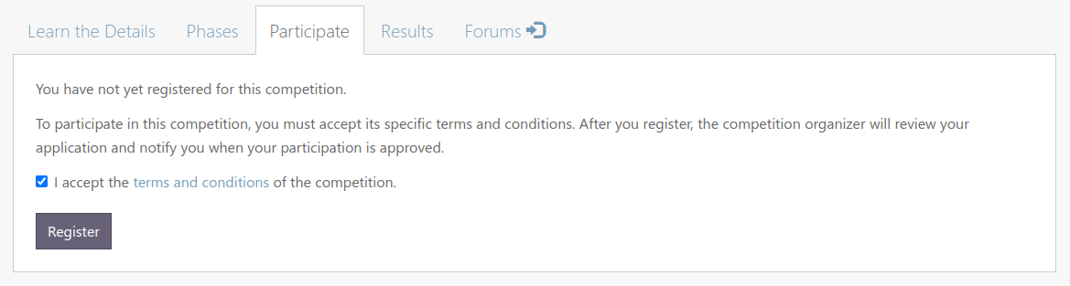
5. the Challenge interface
First, use this tab to register.
Important: Participants have to declare belonging to a team (see Terms and Conditions > Registration)

Slide 32
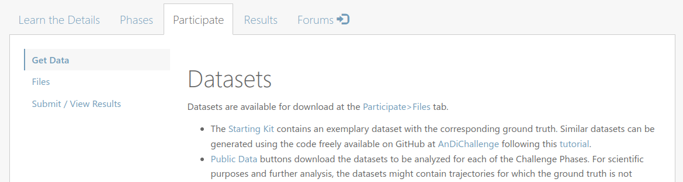
5. the Challenge interface
Description of the data

Slide 33
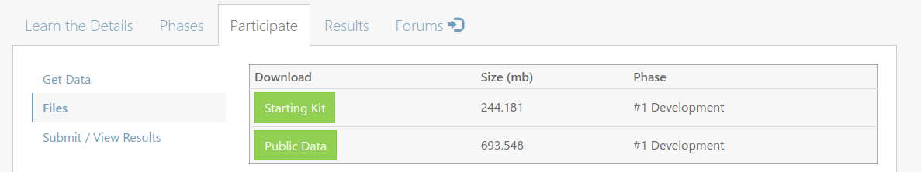
5. the Challenge interface
Template data with solutions.
Can be generate with andi_dataset (see Tutorials > Challenge 2 submission, link)

Slide 34

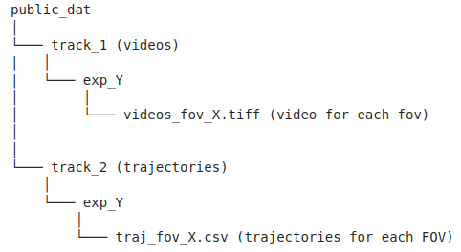
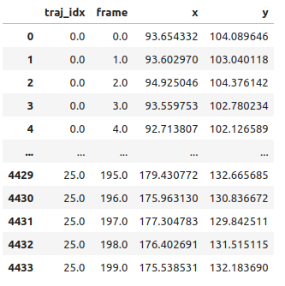
5. the Challenge interface
Videos and trajectories to characterize
All details in andi_datasets > Tutorials > Challenge 2 submission (link)

Slide 35
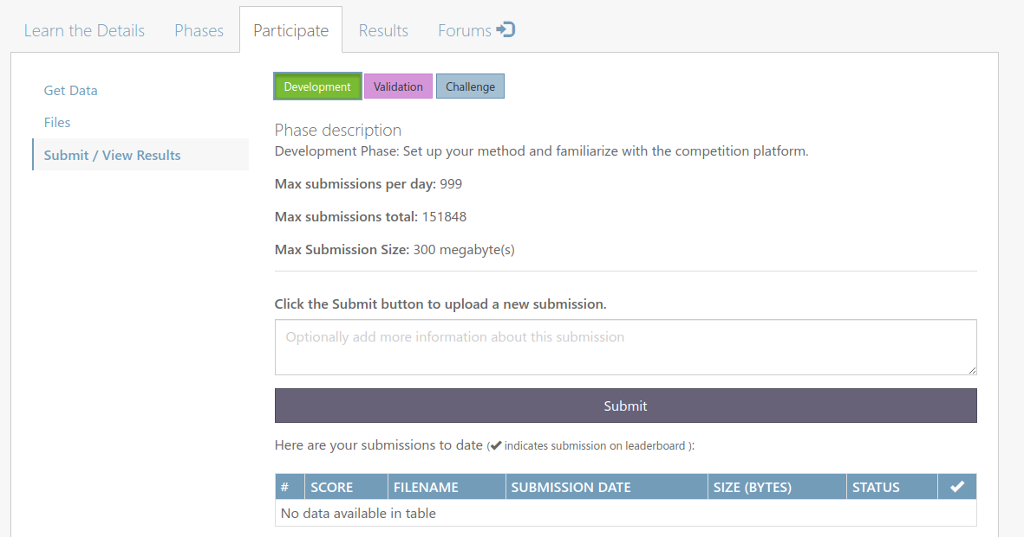
5. the Challenge interface
Most important button, sends your submissions!

Slide 36
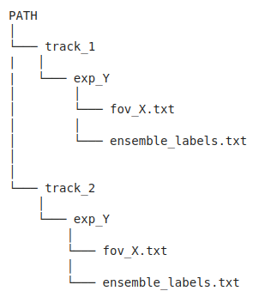
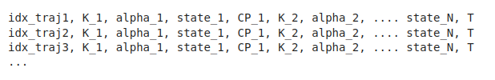
5. the Challenge interface
Submission, a zip file containing:
Predictions for single-trajectory task, for each FOV and each trajectory (VIP for Track 1)
correctly index based on .csv or index on first frame of .tiff (VIP)
length of the trajectory

Slide 37
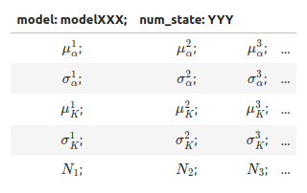
5. the Challenge interface
Submission file:
Predictions for ensemble, only one per experiment
names of models:
single_state, multi_state, immobile_traps, dimerization, confinement
(not accounted for metrics!)
must be equal to number of columns
All details in andi_datasets > Tutorials > Challenge 2 submission (link)

Slide 38
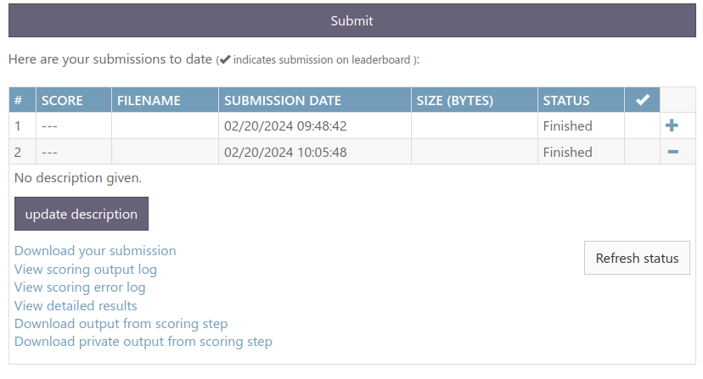
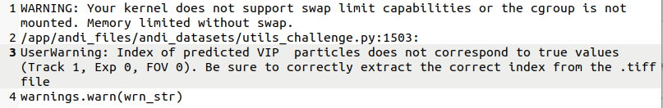
5. the Challenge interface
info about your submission (where it failed)

Slide 39
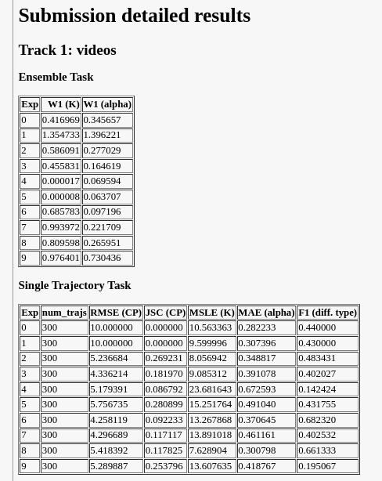
5. the Challenge interface

Slide 40
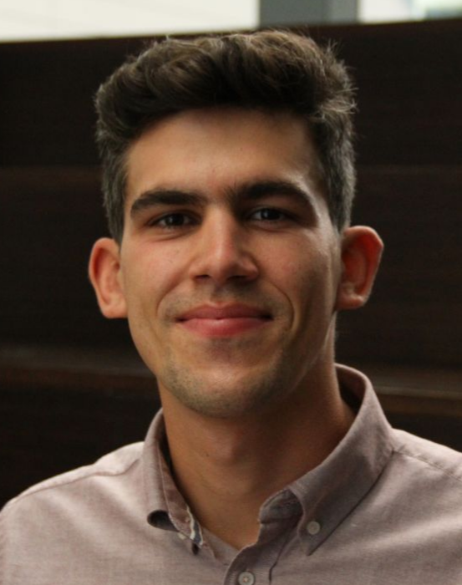





In case you have questions / issues:
Challenge related: Forum in Codalab (link) (+ Team formation thread, link)
Dataset generation: open issue in github>andi_datasets (link)
Other: andi.challenge@gmail.com
Organizers:
Gorka Muñoz-Gil
(UIBK)
Carlo Manzo
(U. Vic)
Giovanni Volpe
(U. Goteborg)
Diego Krapf
(CSU)
Maciej Lewenstein (ICFO)
Ralf Metzler
(U. Potsdam)

Slide 41
Good luck and may the diffusion favor you!
Question time!

